Slide 1
Plone on a Budget
How we do it in UW Technology at the University of Washington
Melody Winkle
March 12, 2008

Slide 2
UW Technology
IT support for the University of Washington
Big research university
A lot of diversity in computing platforms and applications

Slide 3
Content Management/Collaboration
We have some homegrown tools (Catalyst)
We added Plone (internal)
Then Confluence (wiki) (internal, mostly)
Planning a SharePoint deployment for the campus
Other departments are running many other applications
Notes:
Content management and collaboration are different types of needs, but these tools do overlap
Other departments are running Plone, Drupal, Joomla, Bricolage, Contribute, Ektron, various wikis, Microsoft CMS, Sharepoint,etc.

Slide 4
We support choice
In a large diverse community, choice is important
There won’t be any one application that works for everybody
In this environment, simple is preferable to complicated
Notes:
We only have so many resources to support all this diversity

Slide 5
Budgets are limiting
That’s not always good
Sometimes it’s where you start
It’s important to set expectations
Notes:
It can be preferable to start with a low budget in a small project, rather than trying to do it all in one fell swoop.
Plone was our first real content management system, and expectations were very high (and the budget not so much). Here it might help to have an experienced outsider come in and help people understand what’s realistic.
The CMS marketplace is still immature, and I expect products will get better. Plone is only 5 years old.

Slide 6
Our team
Two part-time application support people
One small part of a system administrator (handles part of Zope sometimes)
One part-time coordinator (project management, support, etc)
Several talented site managers

Slide 7
Our Plone Sites
A couple dozen collaboration/information sites
Setting up a site for news/announcement feeds
Setting up a site for the public Office of the President site
Public site for Catalyst (homegrown technology tools)
Notes:
These are just the sites in UW Technology.
Some sites are large and active, others are less so. Some are public, but not a traditional published web site.
Catalyst is run separately, but the developer is part of our team. We’re working together more and more.

Slide 8
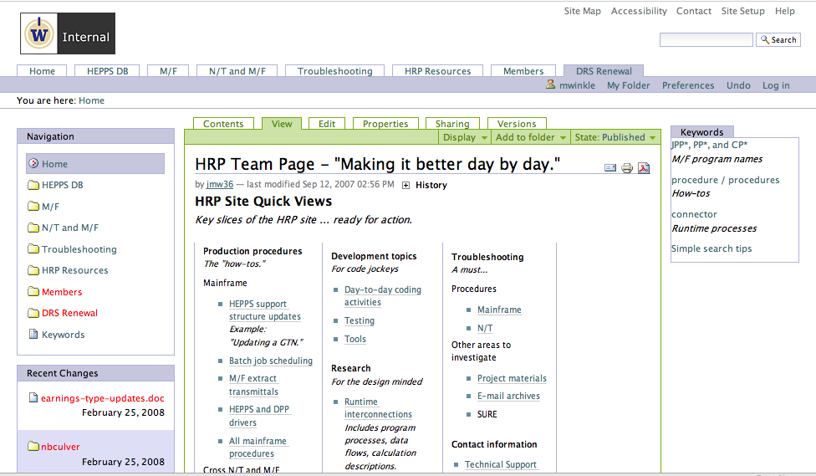

Slide 9
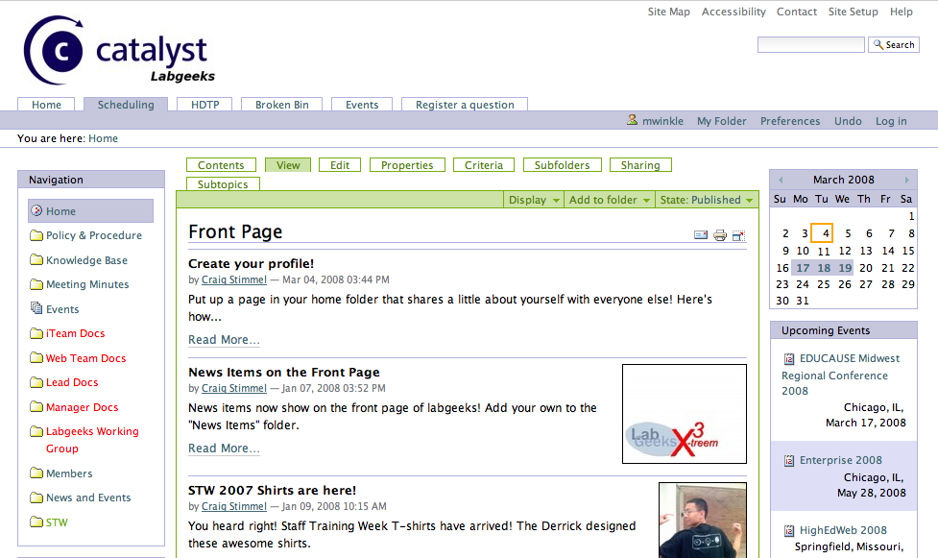

Slide 10
Hosting
Good hosting matters
This is an area where we excel
If you don’t, paying a hosting provider is an option
Costs
Data privacy, policies may be an issue
Notes:
We have great system administrators.
We do go back and forth on how involved the system admin is in running Zope.

Slide 11
One Site or Many
Which is cheaper and easier?
You can argue either way
I think many sites are simpler, especially if you have custom navigation needs or fine-grained access controls
If you have more sites, you can depend on your site managers to handle a certain amount of configuration
Notes:
I’ve heard a number of university types argue the other way – for instance the UW Libraries chose one site, to simplify administrative time.
If you’re offering choices in site configuration, many sites may be easier.

Slide 12
One Zope or Many
Currently we have one production Zope instance
This won’t work for future growth, so we’re working on adding support for more
Once you support products for one group that you don’t want others to have, than it helps to isolate them on their own Zope instance

Slide 13
More on our Zopes
One dev instance
One eval instance (meant for site managers and other active content contributors to try upgrades)
Notes:
It’s very difficult to get users to test upgrades. They seem happy to trust that we’ll get it right.

Slide 14
General Zope Thoughts
Zope scares IT people, especially if they don’t have Python experience
The ZODB makes the average database person nervous (until they realize how stable it is)
If your CMS selection committee includes business users, the chances of choosing Plone go way up
Otherwise you’re looking at .NET, Java, or PHP

Slide 15
Zope on a Budget
If you’re on a low budget, probably Zope will give you pause.
Factors that will push you into the Plone camp are
Usability for authors
Great security
Community
Once you know Plone, it’s not hard.
Notes:
Every system has a learning curve.

Slide 16
Development
Custom programming isn’t cheap
If you’re short on resources, look at out-of-the-box options first
Plone does a lot out of the box.
Students are great, but think about what happens when they leave
Notes:
This is the place where you can quickly escalate current (and future) costs.
Simple site manager customizations can get you pretty far. Especially if you depend on site managers to handle individual sites
Good development practices matter. Not every student is capable, but the ones that are, are worth a lot (and it’s good experience for them).

Slide 17
Good Development Practices
Good development practices will save time down the road
File-system development
Version control
Testing
Adequate documentation
Good coding skills
Notes:
All of these practices add complexity and take more time. They pay off in the long haul though.
For more on good development practices, Joel Burton has a document on “Best Practices for Development”, available on plone.org

Slide 18
Site Managers and the ZMI
We let our site managers into the Zope Management Interface (ZMI)
Most don’t touch it
Some are quite adept at making changes
We’ve only had a few problems with broken sites, which haven’t been difficult to fix.
Notes:
Site managers only go into the ZMI for their own sites.
Undo has been a life-saver. A Google search covers the rest.

Slide 19
Skinning
CSS is the important skill
This is a skill useful in many web applications
A student can be an excellent choice for a skinner
Do realize that you can’t expect an out-of-the-box Plone site to work with a skin developed elsewhere
Notes:
Plone has many ids and classes, so it’ll take some time to work your look into your Plone site.
Some people are looking at an approach to skinning a Plone site with Deliverance, which would allow you to use a skin developed elsewhere.
Paul Everitt will be giving a talk on that.

Slide 20
Third-Party Products
Start cautiously
This is advice we should have taken
Vet the products you choose
You will need a plan to upgrade. They can delay your migrations when they don’t work
It would help to easily see what products others use.
Notes:
Third-party products have taken more time for us than any other aspect (other than perhaps authentication)
To properly vet products now, it takes some amount of research. It helps to know something about the author. What kind of release schedule do they have? How complicated is the product? This topic is worth a presentation in itself.

Slide 21
Products
These are a few of the products we have
LockingWorkFlow (superseded by iterate in Plone 3)
PloneExFile (word indexing in Plone 3)
PloneArticle (may be a keeper)
FCKEditor ?
Notes:
Locking Workflow is used by one group. Iterate takes its place in Plone 3. It doesn’t uninstall cleanly, although if you follow the right procedure, it’s not hard to remove the pieces.
The functionality of PloneExFile (indexing of word/pdf, etc) is in the core of Plone3. This means we’ll need to migrate out of PloneExFile, if we’d like to remove this product. Although PloneExFile is recommended for use with PloneArticle. PloneArticle does have a beta version for Plone3.
FCKEditor has not caused us any problems. I haven’t decided how I feel about it, although some groups prefer it to Kupu (more buttons).

Slide 22
Information Architecture
It’s simplest to set your site up with folders that correspond to groups/departments/units
You can use smart folders/collections to aggregate topic-level information
Keywords work best when the site manager reviews how they’re being used
Notes:
Keywords can add a lot of power to your Plone site. Well-managed controlled vocabularies are never cheap though.

Slide 23
Training
End users don’t require a lot of training in Plone.
They can learn a lot from each other.
A little training is a really good idea though.
Site managers benefit from more training, especially tips and tricks and help with access control.
Developers/integrators should take Joel Burton’s Plone Boot Camp.
Notes:
I would like to offer classes, but for now, we rely on a set of local documentation.
Probably a boot camp is coming your way soon. A nice idea is to host one at your institution. You meet some great people that way.

Slide 24
Support
Site managers provide most of the support
Plone is not difficult to support – end users find it fairly easy to use.
We save on support costs by making an effort to reduce the number of customizations we make.
Notes:
I’ve been surprised how much we can depend on our site managers.

Slide 25
Documentation
We wrote some local documentation.
At the time, I would have preferred collaborating with the learnplone.org group.
Sometimes it’s faster to write your own.
The real issue in doing your own is maintenance.
Notes:
OneNW runs learnplone.org, and they’re our neighbors in Seattle.
We wrote our own to save time, in fact. Also, to have more control.
Actually maintenance is an issue, no matter who does it.

Slide 26
User Groups
The Plone community is the best thing about Plone.
Being part of the community is fun, and your contribution is ultimately reflected in the product itself.
You can tap into the community at a number of levels.
Notes:
The community is one of the most important aspects of open source software. Plone’s community is unusually strong and mature.
Many people are more comfortable starting local and working out.

Slide 27
User Groups
We had a local “Nile” users group, but it was too small to support meetings. We do have a mailing list.
We have a UW Plone Group, which meets every couple months.
We have a Seattle Plone Gathering, which is well-attended.
Notes:
Nile is the name of our local Plone instance (to distingush it from the generic Plone product).
We found that project managers and developers were too busy to go to Nile meetings.

Slide 28
Plone Community
The educational Plone list is sporadically active.
There is a Plone4Universities site
IRC is a great way to get help.
Plone-users is another useful resource.
With all of these resources, it’s not hard to get help with Plone.
Notes:
Personally, I haven’t done IRC yet, but I’m working up to it.
People think open source is risky because of the lack of support (you still hear that). But this is where the community is so important.

Slide 29
How to Contribute
We all have some responsibility to contribute to the community.
It’s fine to start small – help the people around you.
Work up to answering a question in a user group or plone-users or on IRC.

Slide 30
More Ways to Contribute
Join the documentation group.
Report the bugs you find.
Test the beta versions.
Contribute a bug fix.
Contribute code.
Give a talk.
Notes:
The documentation group is sprinting after this conference.

Slide 31
Principles of Simplicity
Don’t make too many customizations, especially at first.
When you customize, do it the Plone way.
Get enough training so you know what the Plone way is.
Make friends with others.
Notes:
Don’t fight the Plone. You will lose.

Slide 32
More Principles
It’s going to be hard for somebody.
If it’s easy for developers, it’ll be harder on users.
If it’s customized for users, it’ll be harder on developers.
Or the core Plone product will take on more complexity, allowing integrators and users an easier time.

Slide 33
Updates
Keep up with the updates. It can be hard to catch up if you get too far behind.
We don’t keep up with all the updates.
Notes:
This is my personal preference – I like getting the new stuff. It gets balanced with reality though.
OneNW doesn’t do updates on sites unless their clients ask for them (usually as part of a feature request).

Slide 34
Where Not to Skimp
Good hosting
Good development practices
Enough training, particularly for developers
Community participation
Notes:
Education is key to understanding how things work.
If these are outside your reach, maybe Plone isn’t for you, at least not yet.

Slide 35
The Future is Bright
Plone is getting better
We’re looking forward to moving to version 3
The community keeps getting stronger
The first strategic planning meeting was held in February
Notes:
Our move to Plone 3 isn’t imminient, but we’re setting the stage.
How many content management system communities have open strategic planning sessions?

